Slide 1
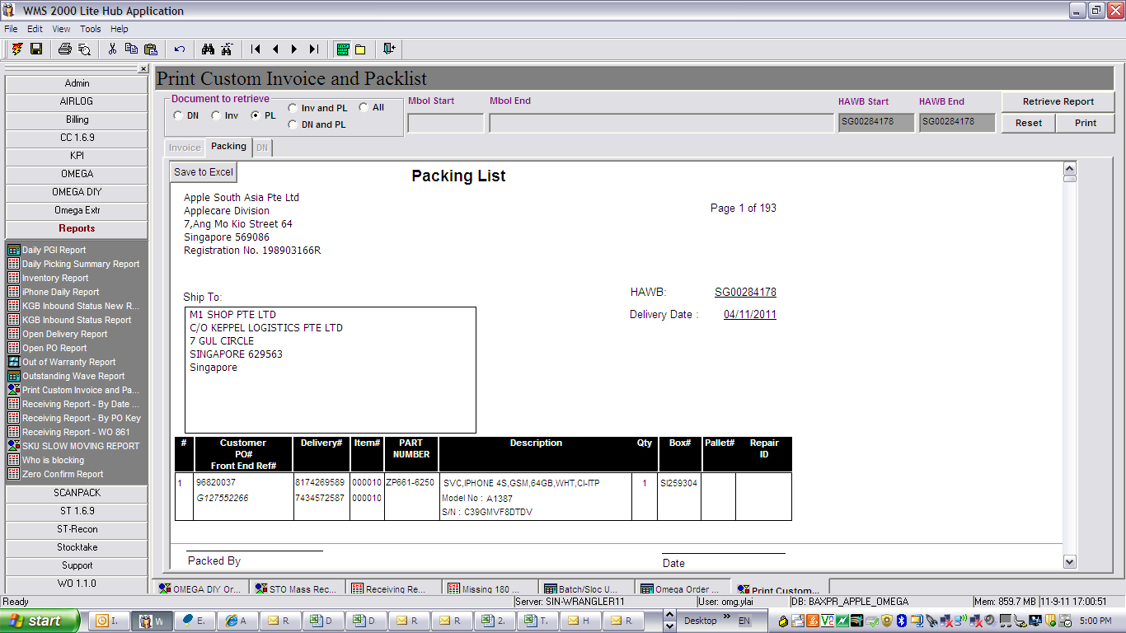
Header remained
Boxes # = LP #

